Slide 1
IST_687
Group 5

Slide 2
Agenda Style
01
Introduction
02
Data Process
Cleansing, Selection, Data Descriptive
03
Model Process
Linear Regression, Ordinal Regression, SVM
04
Summary

Slide 3
Some Cool Stuff!!

Slide 4
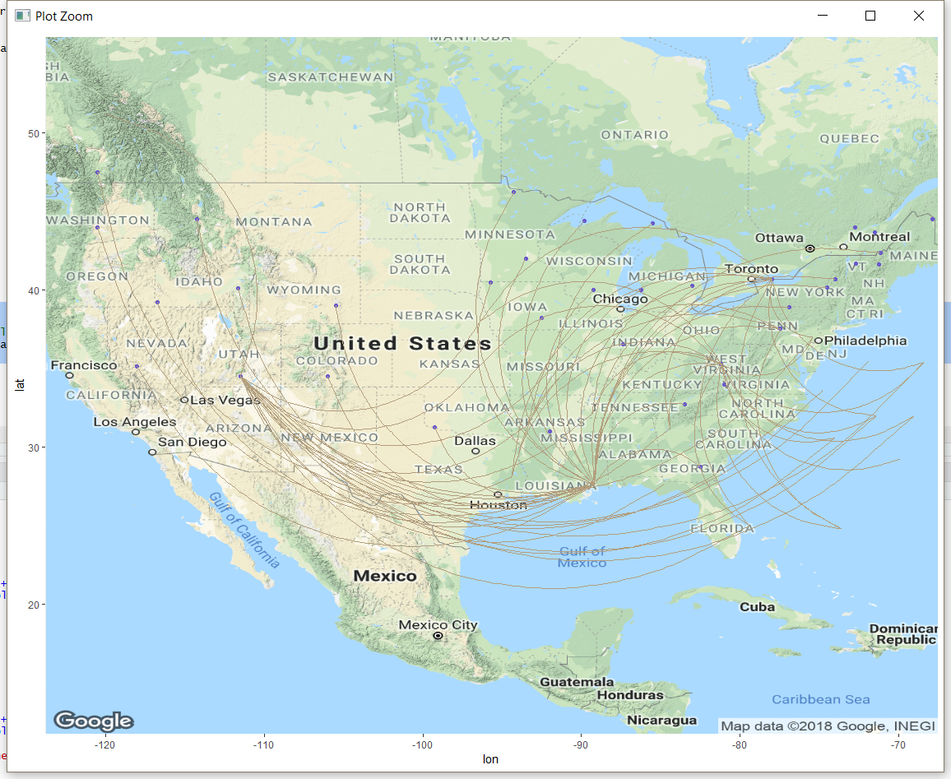



Slide 5
Introduction

Slide 6

Introduction
Dataset:
130,000 Airline Customers’ Surveys
Satisfaction
28 Flights’ and Customers’ Attributes
Client:
Southeast
Target
Improve Satisfaction

Slide 7
Business Questions
Factors which tend to influence satisfaction, and which ones are the most effective?
What are the current problems that the airline industry faced in improving customer satisfaction?
Ways to improve to solve current problems for Southeast airlines customers?
How does the current satisfaction variable diverse through different Gender, Airline Status, Airline Class, Age, Price Sensitivity, Travel Type, and Flight Cancellation Status, etc.?
Can we identify a trend or feature for people who are more likely to give higher satisfaction score as well as lower satisfaction score?

Slide 8
Data Processing

Slide 9
Cleansing
NAs
Unusual Data
Rounding

Slide 10
Visualization & Descriptive Statistics

Slide 11
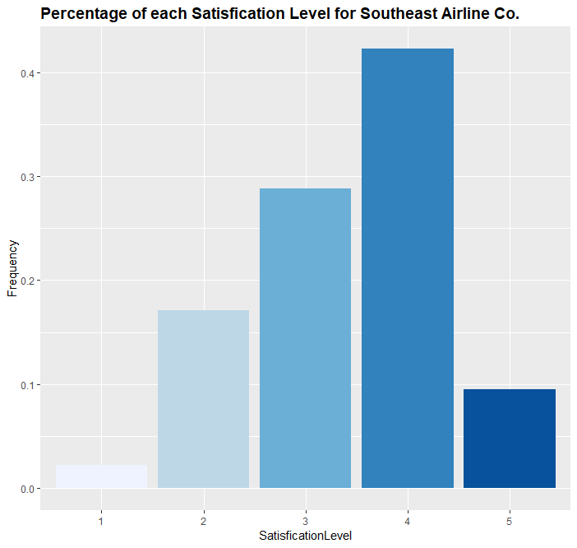



Satisfaction(cont.)

Slide 12
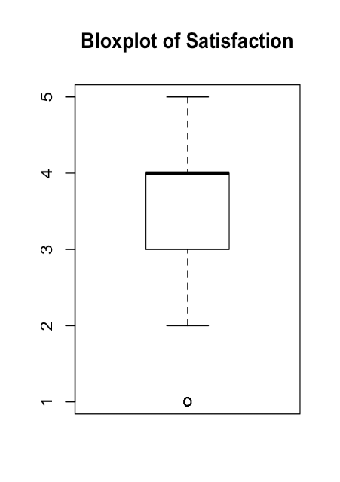
Satisfaction: Southeast Airline Co.
Statistics
Mean | 3.4
Variance | 0.91
Std. Dev. | 0.95
Minimum | 1
Maximum | 5
Range | 4
1st Quartile | 3
3rd Quartile | 4
IQR | 1
Median | 4
No big difference between Industry & Southeast Airline
1st : Satisfaction 4; 2nd : Satisfaction 3
Assume:
>3 → High score
Customers more likely to offer a slightly higher than or around the average Satisfaction

Slide 13
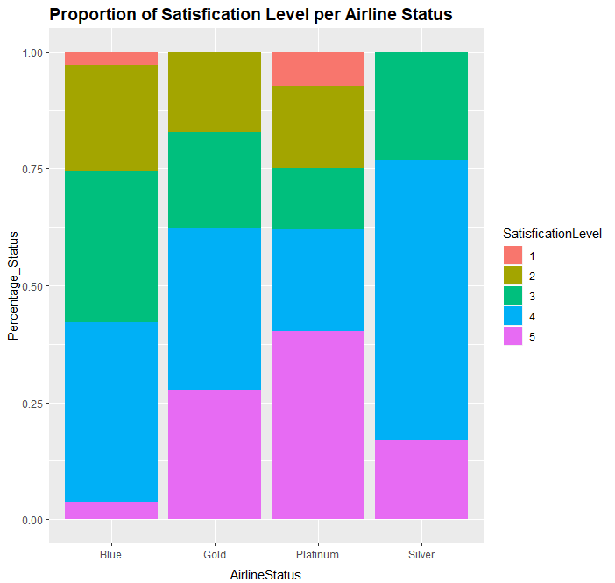
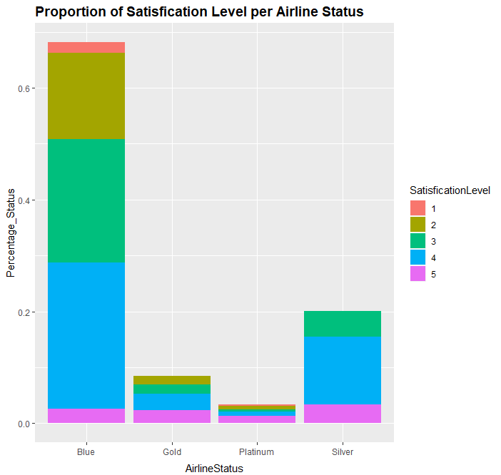
Satisfaction vs. Airline Status
Biggest number of group: Blue
Silver: highest 4-Satisfcation
Platinum: highest 5-Satisfcation
Assumption: Silver & Platinum are correlated to a higher Satisfaction level

Slide 14
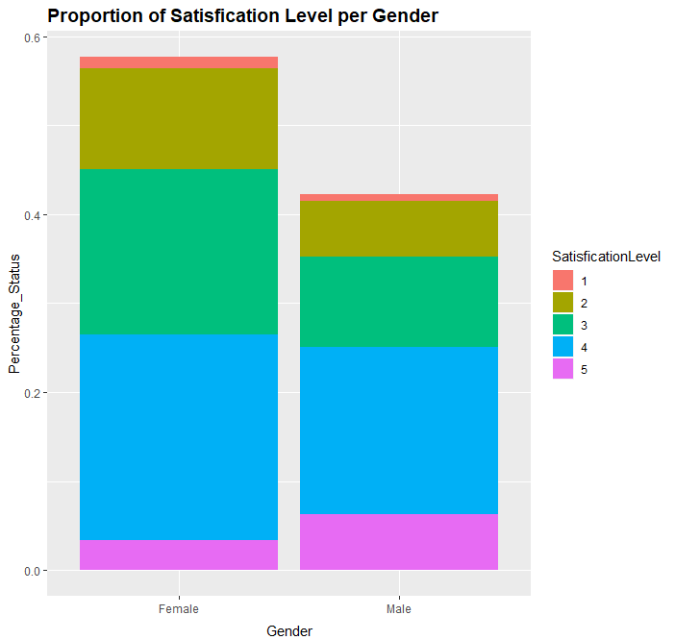
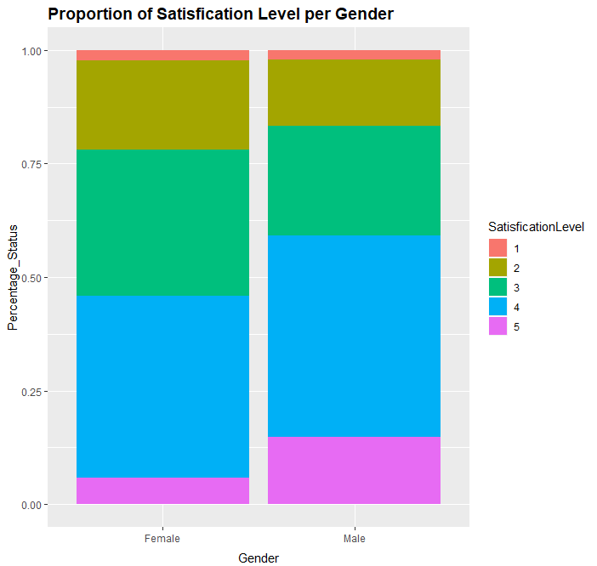
Satisfaction vs. Gender
Total amount: female > male
Men: higher Satisfaction & more 5 level Satisfaction; women: vice versa
Assumption

Slide 15
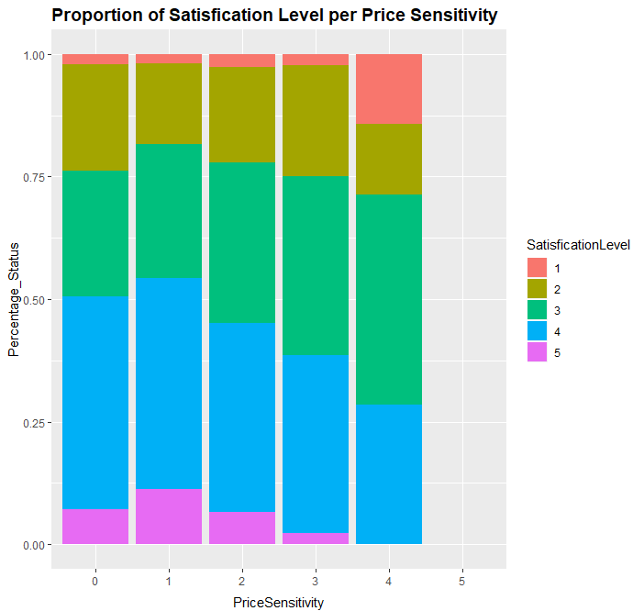
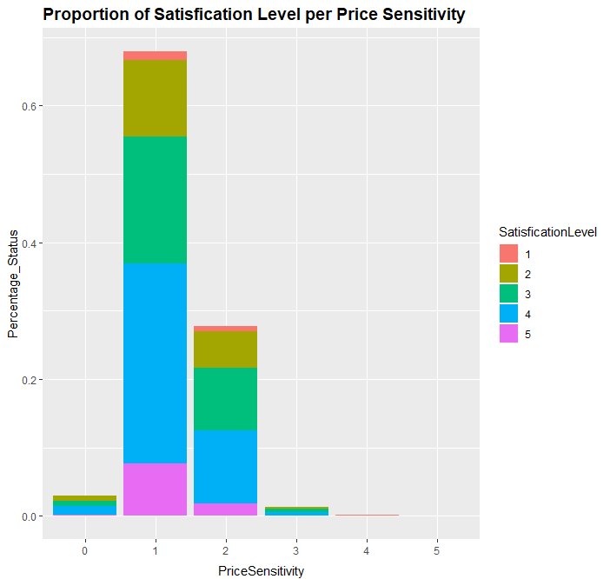
Satisfaction vs. Price Sensitivity
Customer with Price Sensitivity 1 provide the largest amount of Satisfaction
Customer with Price Sensitivity 1 provide the highest Satisfaction score & Price Sensitivity 4 provide the lo-west Satisfaction score
Assumption

Slide 16
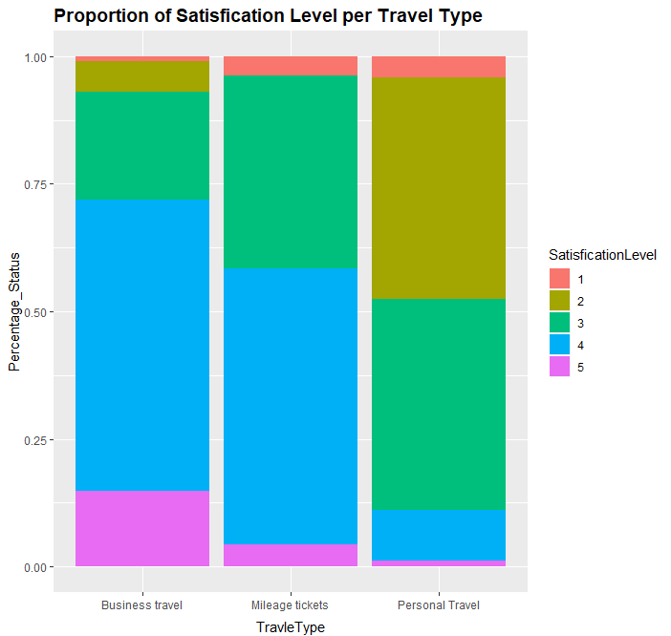
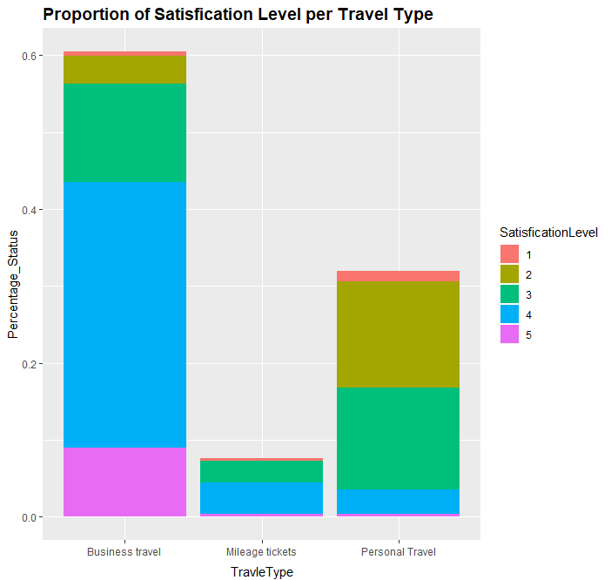
Satisfaction vs. Travel Type
Business Travel Type: the largest number of Satisfaction; Mileage tickets: the lowest number of Satisfaction
Business Travel→ higher Satisfaction
Personal Travel→ lower Satisfaction

Slide 17
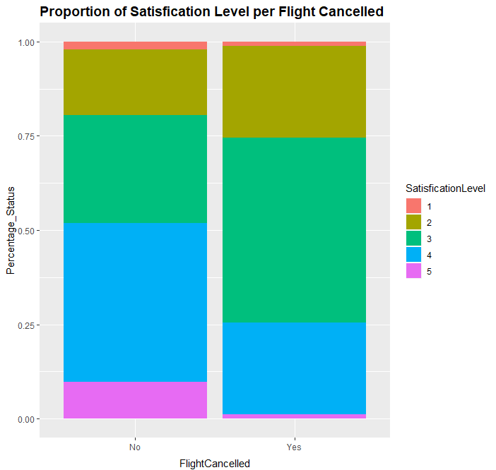
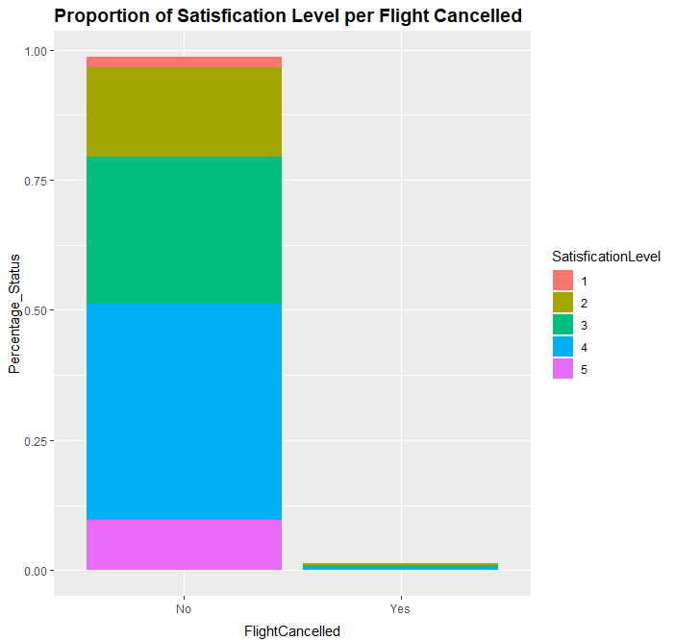
Satisfaction vs. Flight Cancelled
Dramatic difference between Flight Cancelled(Yes) & Flight Cancelled(No);
People with Flight Cancelled will provide much wor-se Satisfaction

Slide 18
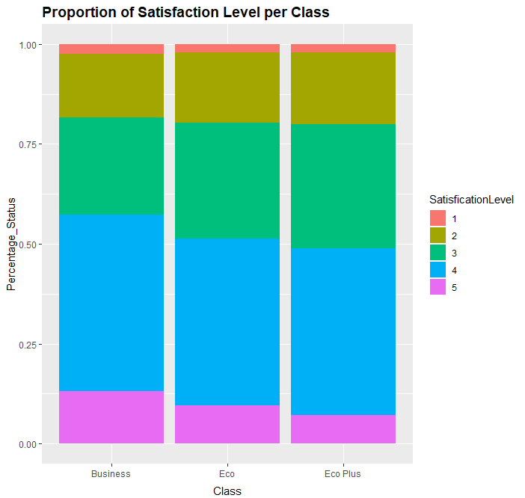
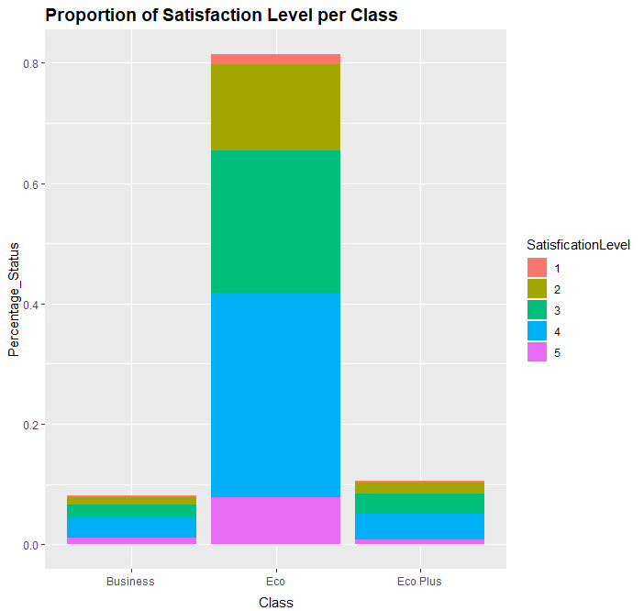
Satisfaction vs. Class
Eco: largest amount of Satisfaction
The higher Satisfaction: Business & Eco
The lower Satisfaction: Eco Plus

Slide 19
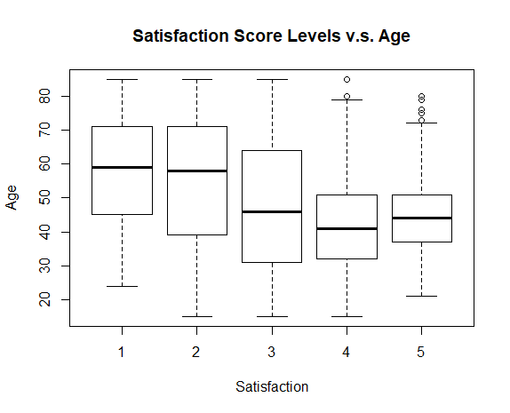
Satisfaction vs. Age
Generally: the lower the age, the higher Satisfaction
However, Level 5 Satisfaction’s corresponded Age is slightly higher than Level 4 Satisfaction’s corresponded Age
Assumption

Slide 20
Data Selection
MCA
Dimension Explain Power
Variables R^2 and P-value
Reduced From 26 to 19
Association Rules
Preset satisfaction > 3 as “y”, <=3 as “n”
Prove the 19 variables from previous method are significant
Reduced the variables from 19 to 10

Slide 21
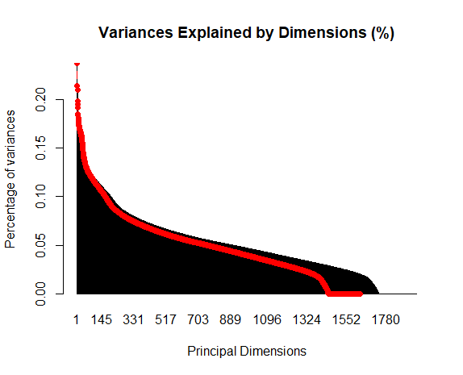
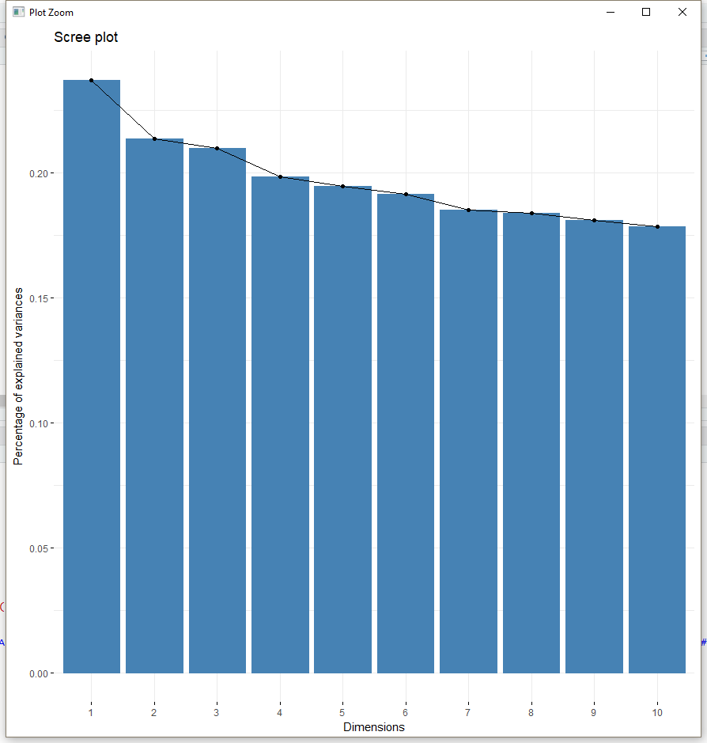
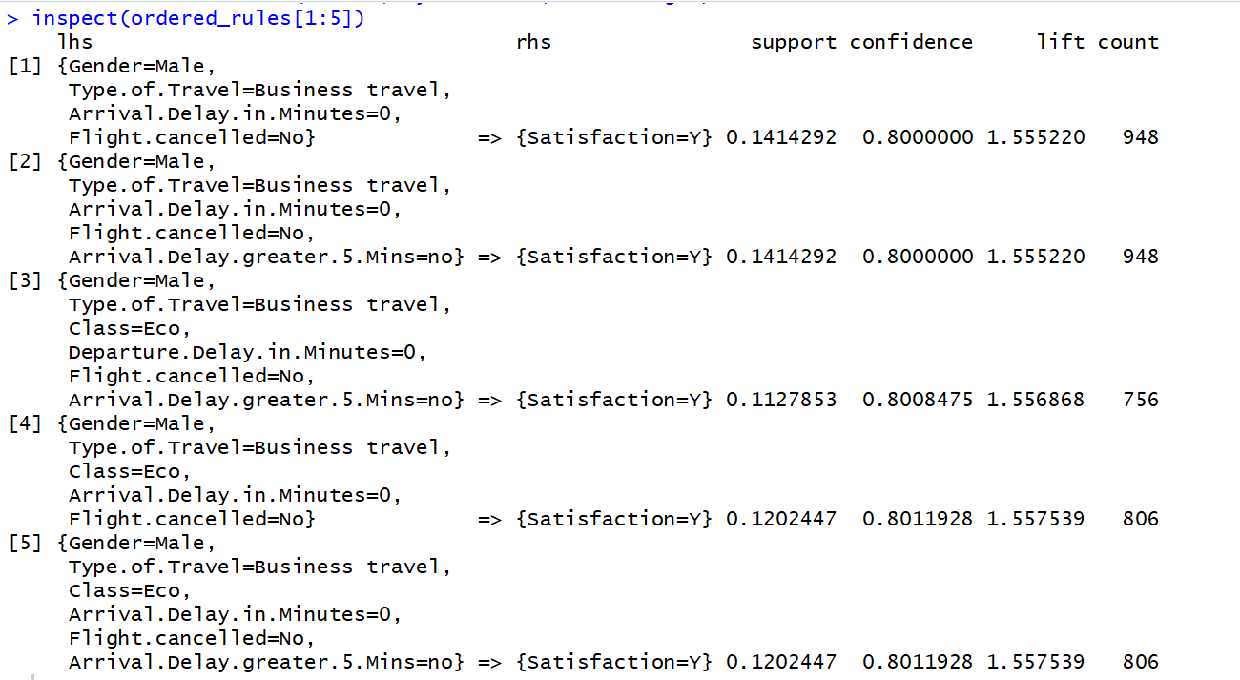
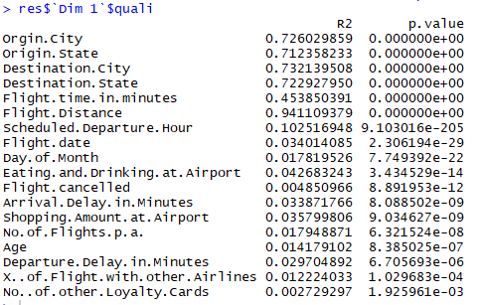
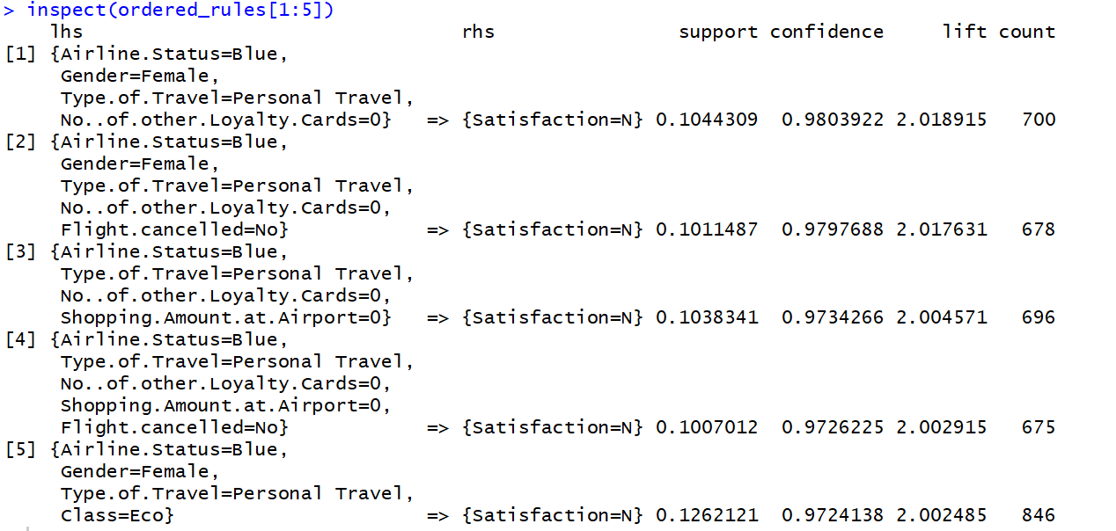
Data Selection

Slide 22
Model

Slide 23

Linear Regression
Travel Type: Personal Travel
Gender: Female
Arrival Delay>5
Class Economy Plus
Airline Status Blue
Flight Cancel
Adjust R Square: 0.4385
Accuracy Rate: 55.71%
Older People
Number of Flights in the Past

Slide 24
Ordinal Logistic Regression
Gender: Female
Arrival Delay > 5mins
Older People
Class: Economy Plus
Number of Flight in the Past
Flight Cancel
Travel Type: Personal Travel
Airline Status Blue
Departure Delay
Years of First Flight
Arrival Delay < 5mins
Adjusted R Square: 0.4338
Accuracy Rate: 59.46%

Slide 25

Support Vector Machine
Predictors：
Airline Status
Age
Gender
Number of Flights in the Past
Type of Travel
Flight Cancelled
Arrival Delay is Greater than 5 minutes
Class
Accuracy
Predicted Satisfaction (Y or N) v.s. Actual Satisfaction
Error rate: 19.97%
Accuracy rate: 80.03%
Y (Satisfied)
N (Unsatisfied)

Slide 26
Summary

Slide 27
Recommendation
Type of Travel -Do a survey just based on these customers.
Gender - Provide more feminine care to improve women’s satisfaction level. And more help to mothers who carry babies. For example, we can set some area for baby-carrying mothers. By doing this, these babies won’t influence other passengers and mothers won’t feel uncomfortable when they take care of babies.
Airline Status - Most people are under the Blue Status and they are the least satisfied. So Southeast should focus on improving the policies for blue status or improve their service

Slide 28
Recommendation
Class -Southeast can investigate their Economy Plus services and management to find out what is making Economy Plus customers unhappy
Age - Southeast could provide wheelchairs and accompanies at the airports and emergency aid for olds at the planes. So that the old won’t feel lonely. The more reasons should be discussed by employees of Southeast.

Slide 29
Thank You !

